Slide 1
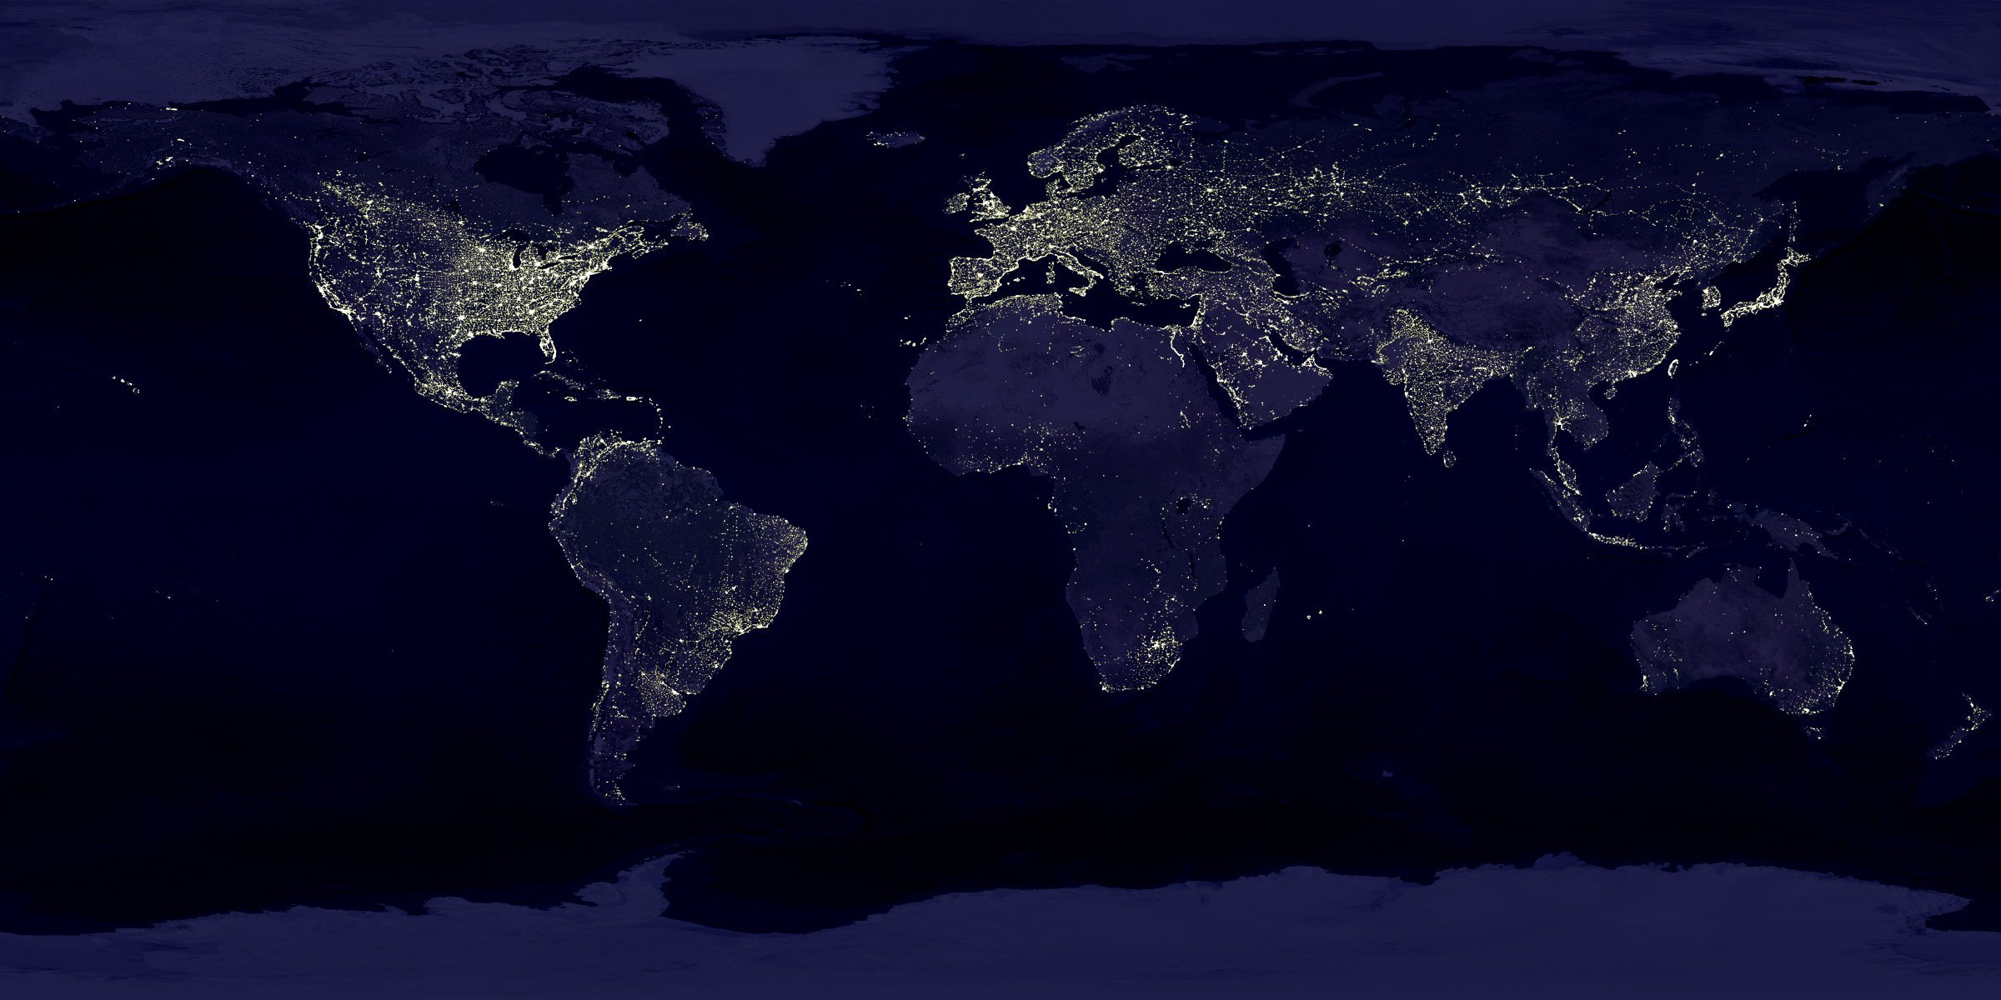
M
E
D
I
A
G
N
O
S
E
Identification of Disease and Suggesting References Based on Symptoms Developed using Machine Learning and Integrating it with Web App
Niharika Jain [2019PUSCEBCEX07635]
Prakhar Saxena [2019PUSCEBCCX07276]
Prikshit Saini [209PUSCEBCCX07153]

Slide 2

01
Introduction
Contents
02
Workflow
03
Features

Slide 3
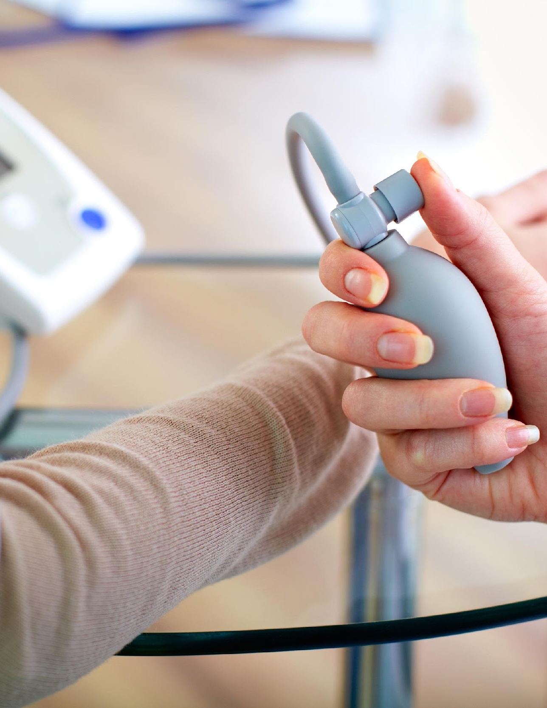
PART 01
INTRODUCTION to MEDIAGNOSE
AIM and OBJECTIVE

Slide 4



Introduction to MEDIAGNOSE
Objective
We have designed a disease prediction system using multiple ML algorithms. Based on the symptoms, age, and gender of an individual, the diagnosis system gives the output as the disease that the individual might be suffering from. This application is also able to read and Provide Health Tips, Pre-Diagnosis and related Details of the Disease.
Predicting the Disease based on Symptoms
Detailed Information about the Identified Disease
Suggesting Health tips

Slide 5


INTRODUCTION Of MeDIAGNOSE
We have designed a disease prediction system using multiple ML algorithms. Based on the symptoms, age, and gender of an individual, the diagnosis system gives the output as the disease that the individual might be suffering from.Provide Health Tips Details in India.
The intelligent diagnosis problem to be solved in this project includes two aspects. The first one is seeking diagnosis experience according to the relationships between symptoms and diseases. Here, supervised machine learning methods are adopted. The second one is disease prediction based on the symptoms provided by visitors.
In this project, medical data are divided into three copies, records related to main disease categories, records related to subclass disease types, and records of specific diseases firstly; then two disease recognition methods only based on symptoms for the main disease category identification, subclass disease type identification, and specific disease identification are given. In the method validation part, accuracy of the two diagnosis methods is tested and compared. Results show that automatic disease prediction only based on symptoms is possible for intelligent medical triage and common disease diagnosis. After the disease Identification the treatment Along with Health tips

Slide 6
Market Analysis of MeDiagnose
the market analysis shows thar from 2018 the health industry earns 27.7 billion dollar with expansion ofthe application gives 121.1 billion dollar
121.1
Market analysis In Billions
27.7
2030
2018

Slide 7
PART 02
WORKFLOW to MEDIAGNOSE
Proccessing and Modulation

Slide 8
METHODOLOGY
Requirement Gathering
Project Designing
Testing
Project Estimation Analysis
Development
Deployment
Step
Step
Step
Step
Step
Step
01
02
03
04
05
06

Slide 9
Process of Designing for Me DIAGNOSE
Cleaning of data
Modelling
Inferences
Data Collection
Deciding and analyzing Parameters
(7000 Transactions Data)

Slide 10
Modulation of MeDIAGNOSE
Recommendations
Healty Tips
Predicting Disease
Details of Disease
The methods are suitable for the diagnosis of common diseases and disease triage for specialized diseases. The availability in practice is proved and analyzed in the experiments of this paper. In addition, future research is also required to investigate automatic symptom extraction and discuss the maximum number size of symptoms.

Slide 11
Dedicated Timelines
Frontend
Database
Machine Learning
Back-end

Slide 12
Stages of Development
Creating Frontend
Training Model
Creating Django Base
Buiding Connection with third party application
Deployment

Slide 13
PART 03
FEATURES of MEDIAGNOSE

Slide 14






Features OF MeDIAGNOSE
Predicting and Identifying Disease Based on Symptoms
Provide Awareness of Disease
Provide Recomendation of websites to check
Health Tips
Search Engine with Neural Networks
Finding Researches and Latest News updates

Slide 15
Feature Implimantation Impacts
SQL, CSV, Jira
15%
Database administrator
HTML, CSS, JS
20%
Frontend Development
01
02
03
04
Backend Development
20%
Django
Machine Learning
45%
Machine Learning , Neural Network

Slide 16
GLANCE at MeDiagnose

Slide 17
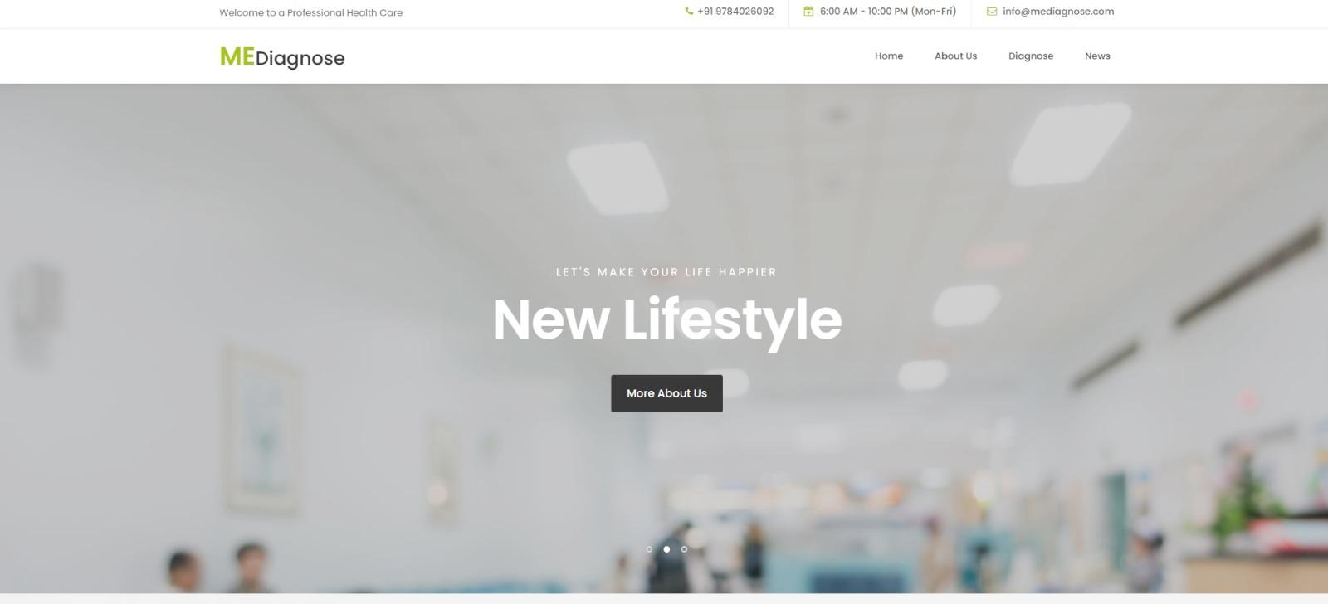

Slide 18
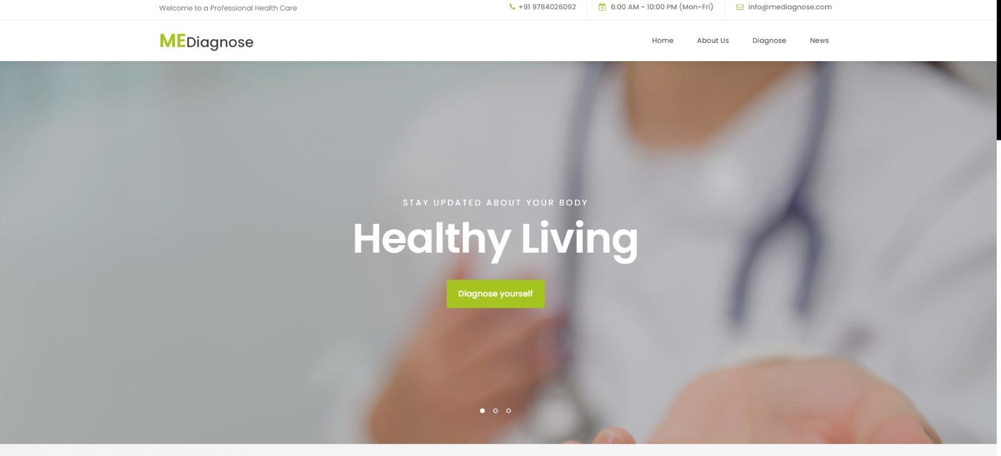

Slide 19
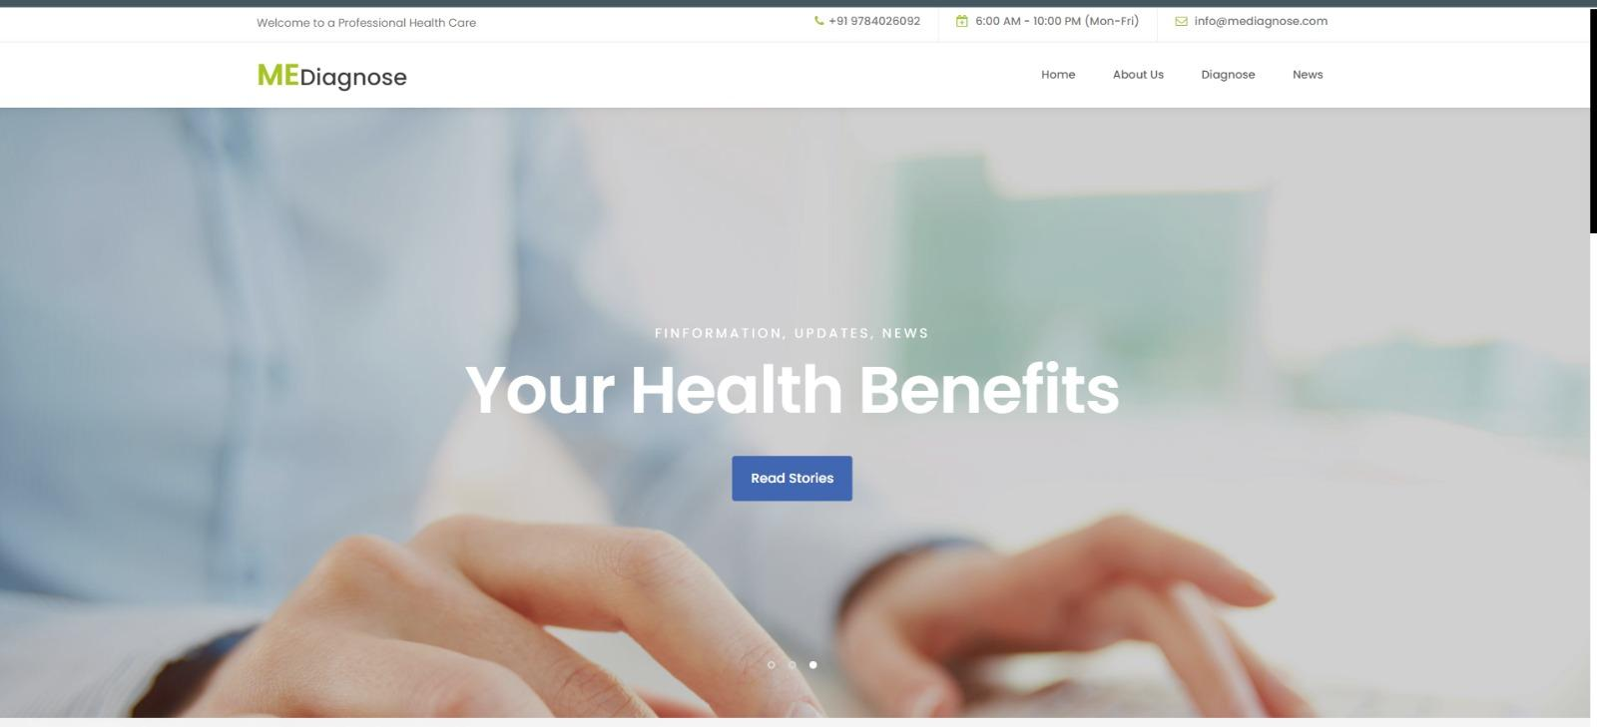

Slide 20
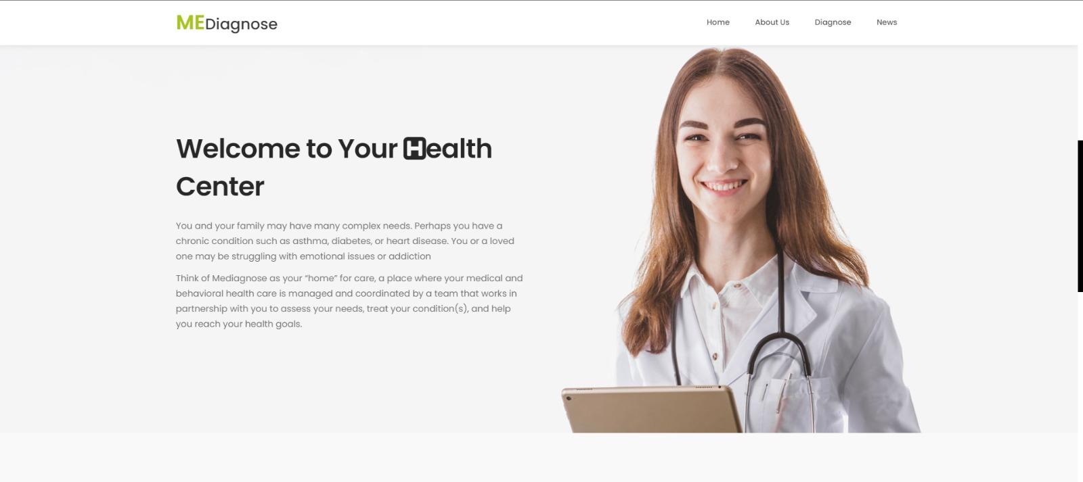

Slide 21
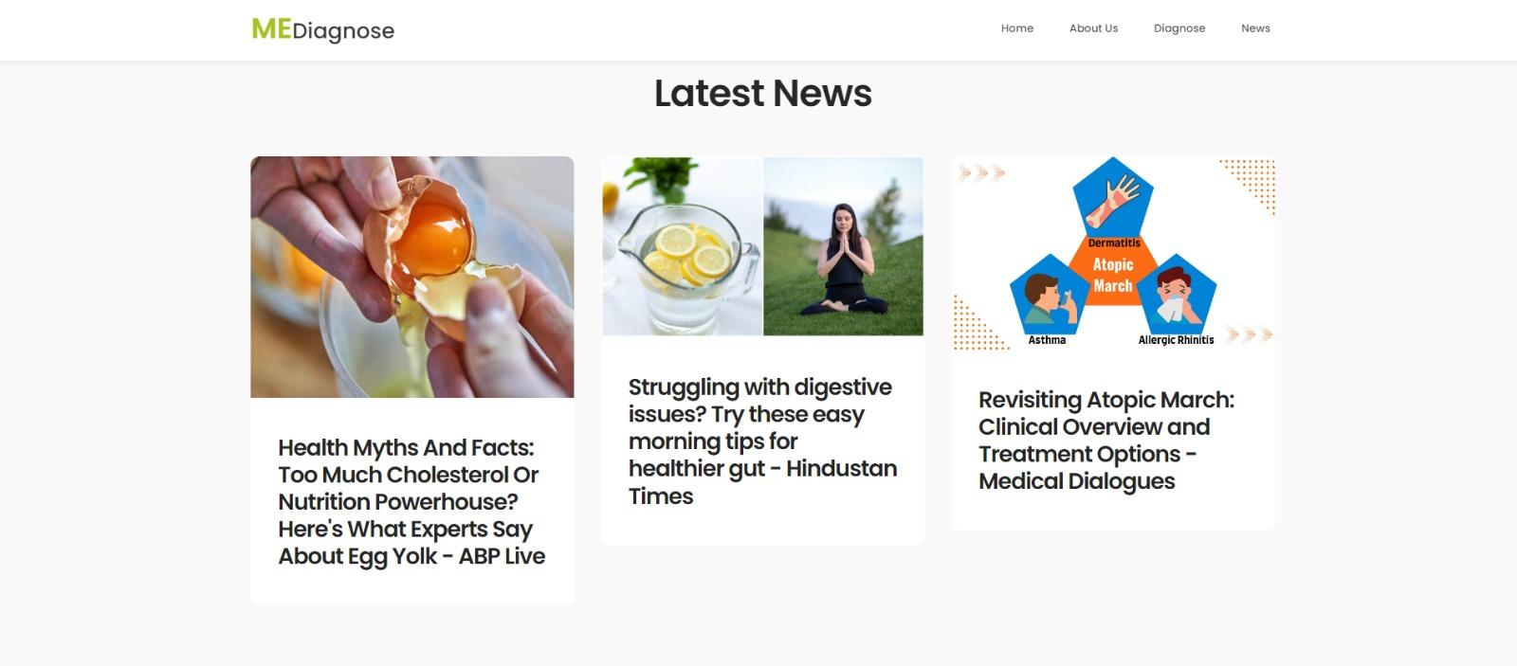

Slide 22
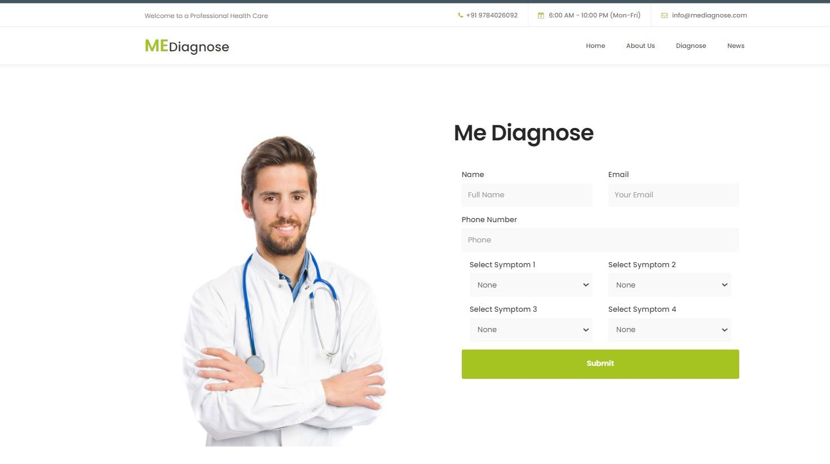

Slide 23
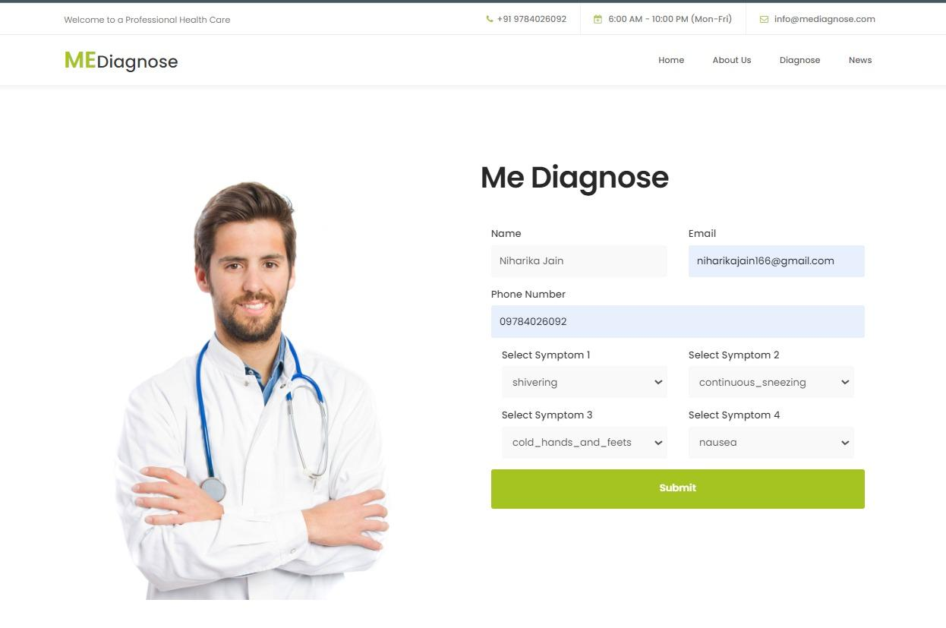

Slide 24
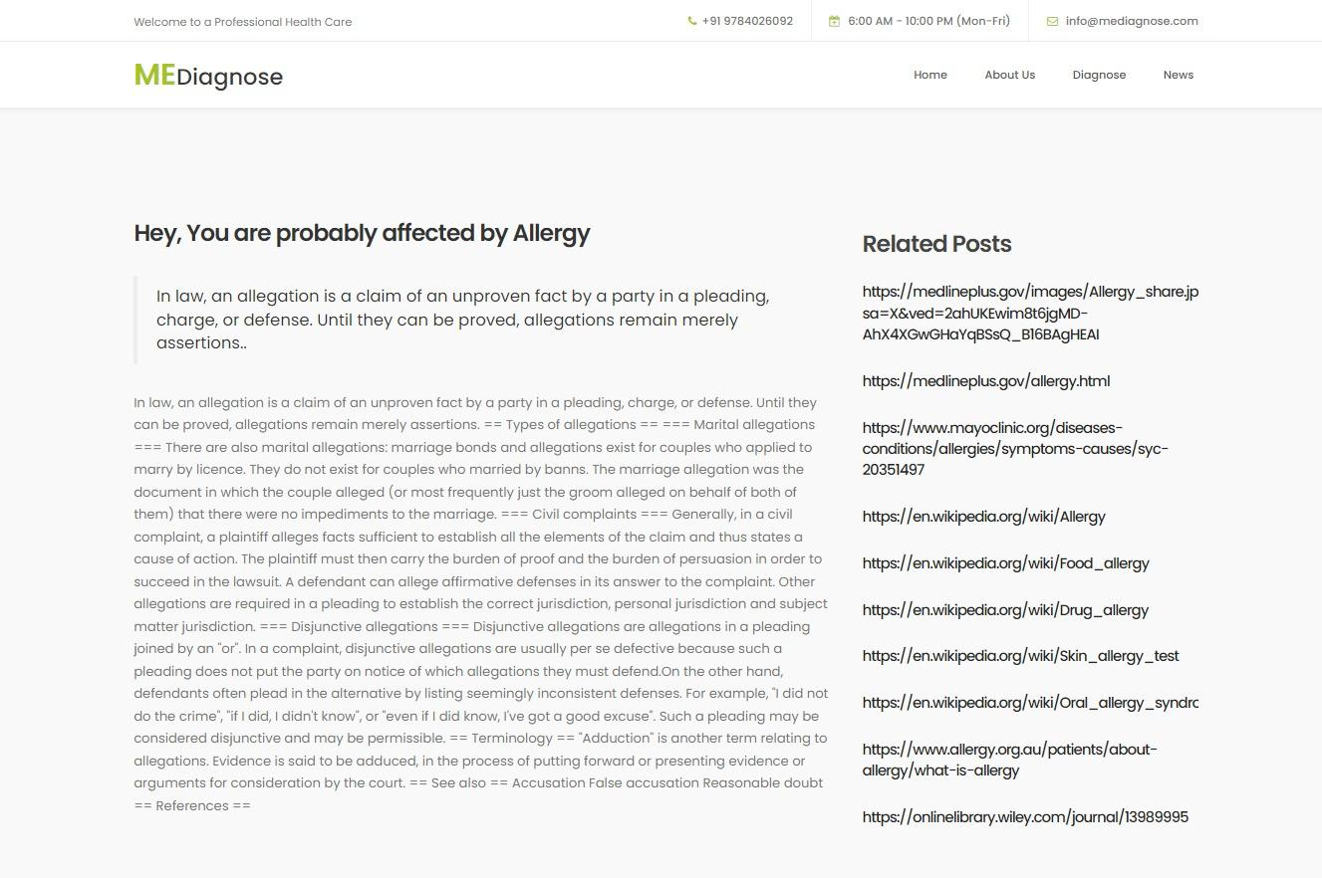

Slide 25
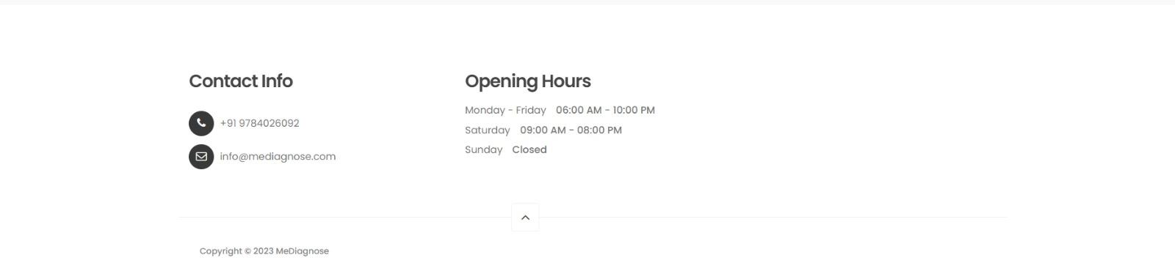

Slide 26
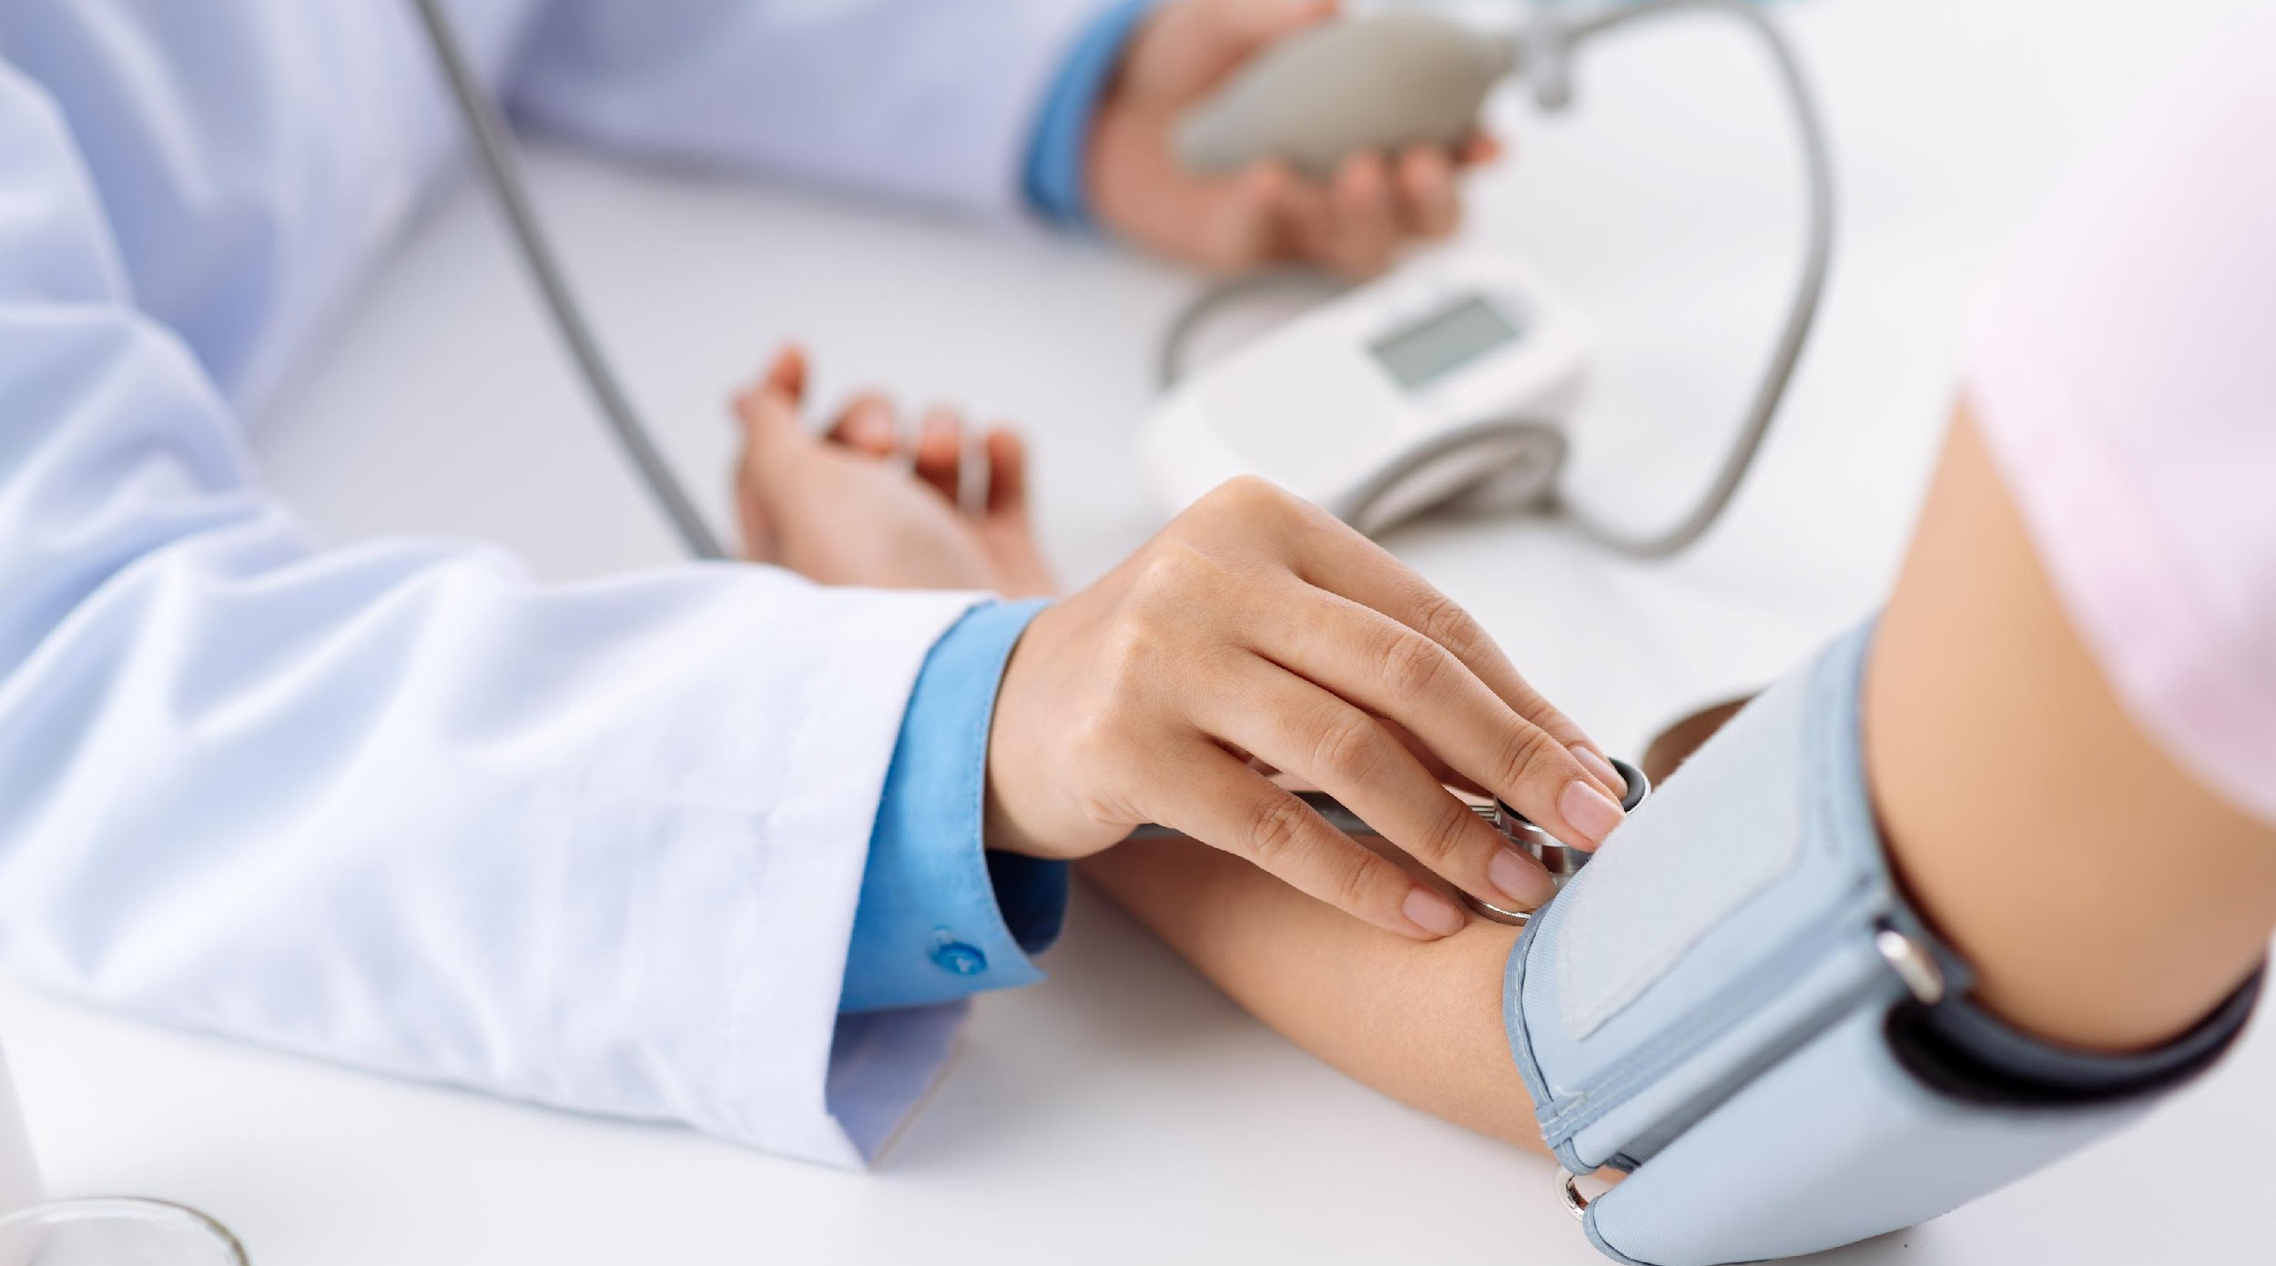
<MEDIAGNOSE>
THANK YOU！
Date：23.12.2022
Reporter：Niharik Jain, Prakhar Saxena, Prikshit Saini

